Slide 1
Predicting Landing Solutions for a Rocket in a Two-Body System
Spring 2014 · Honors
Professor Thorp · C++

Slide 2
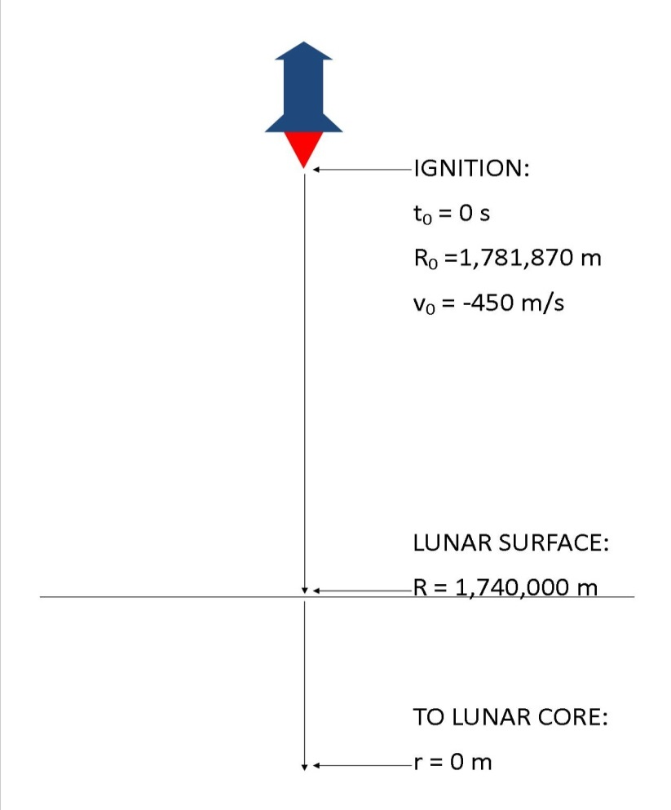
Overview & The Model
Conduct a parameter study to:
identify the relationships between parameters in a mathematical model.
Investigate the reliability of curve fitting numerical landing solutions from the model (e.g. y=f(x)).
Edwards, C. Henry, and David E. Penney. Differential Equations & Boundary Value Problems Computing and Modeling. 4th ed. Upper Saddle River: Pearson Custom, 2008. Print.

Slide 3
Numerical Methods & C++
Advantages of numerical methods:
Provide an alternative for solving non-linear ODEs.
Easily implemented as a computer program.
Commonly found in industry (aerospace & finance).
Our numerical methods:
The Euler method
4th Order Runge-Kutta.
Using the C++ programming language we:
Added additional code to handle systems of equations.
Reduced trial times and human input error.

Slide 4
Case Study & Parameter Study
Case Study
Used a 2nd order non-linear ODE.
Validated the RK4 integrator using the expected case study values.
Parameter Study
Collected 21 data points.
Plotted the points and applied a quadratic fit to the data set using Microsoft Excel.
Interpolated 6 points and extrapolated 8 points.
Drew conclusions based on metrics such as percent error.
Extrapolated using different curve fits.

Slide 5
Results & Future Investigations
Identified the conditions needed to obtain reliable curve fits.
This technique can be used for non-aerospace models.
Our project received positive feedback from academia and industry.
Future Investigations
Implement more complex numerical methods.
Develop a more complex aerospace model by introducing the following parameters.
Drag using standard atmosphere data at multiple altitudes.
Mass reduction due to fuel burn.
Drag and mass reduction from rocket staging.

